Slide 1
Causal Inference Crash Course Part 6: Difference-in-Difference Models
Julian Hsu

Slide 2
Causal Inference Series
Foundations
Defining Some ATE/ATET Causal Models
ATE/ATET Inference, Asymptotic Theory, and Bootstrapping
Best Practices: Outliers, Class Imbalance, Feature Selection, and Bad Control
Heterogeneous Treatment Effect Models and Inference
Difference-in-Difference Models for Panel Data
Regression Discontinuity Models
Arguable Validation

Slide 3
Overview
Difference-in-differences (diff-in-diff) is the most popular quasi-experimental design in economics for causal inference.
One quarter of NBER Working Paper series used diff-in-diff; and
16% of articles in top five economic journals (Currie et al, 2020)
It exploits panel data to estimate causal impacts
A related method is synthetic control, which is covered else where.

Slide 4
Defining the difference-in-difference estimator

Slide 5
Foundation using panel data
Panel data is when each subject is tracked across multiple time periods. For example, knowing the purchase history of a given customer or account for each calendar day.
With greater data storage capacity, panel data is becoming more available to scientists for analysis.

Slide 6
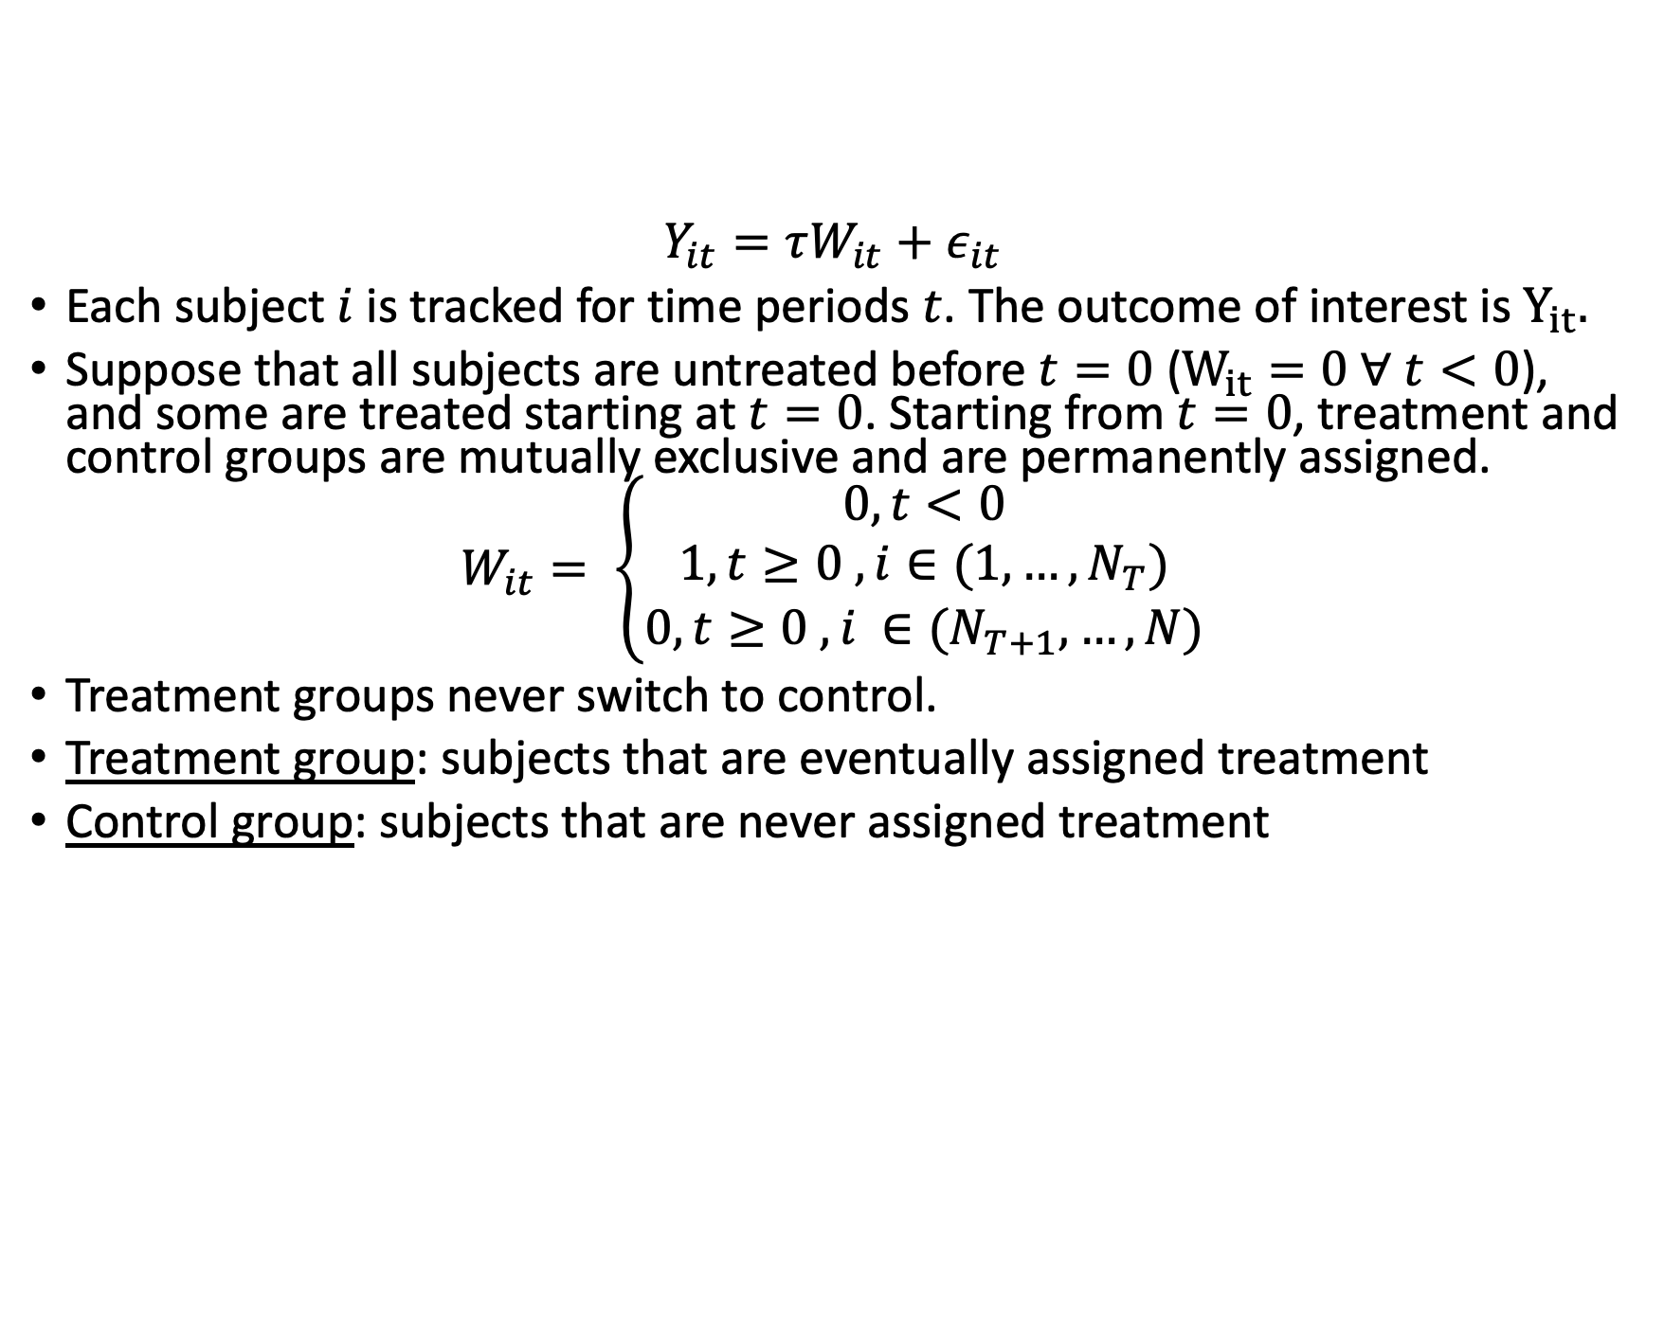
Simple panel data set
$$Y_{it}=τW_{it}+ε_{it}$$
Each subject $i$ is tracked for time periods $t$. The outcome of interest is $Y_{it}.$
Suppose that all subjects are untreated before $t=0$ ($W_{it}=0 ∀ t<0$), and some are treated starting at $t=0$. Starting from $t=0$, treatment and control groups are mutually exclusive and are permanently assigned.
$$W_{it}= \left\{\begin{aligned}0, t<0 \\ 1, t≥0 &, i∈(1,…,N_{T})& \\ 0, t≥0 , i ∈(N_{T+1},…,N)\end{aligned}\right.$$
Treatment groups never switch to control.
Treatment group: subjects that are eventually assigned treatment
Control group: subjects that are never assigned treatment

Slide 7
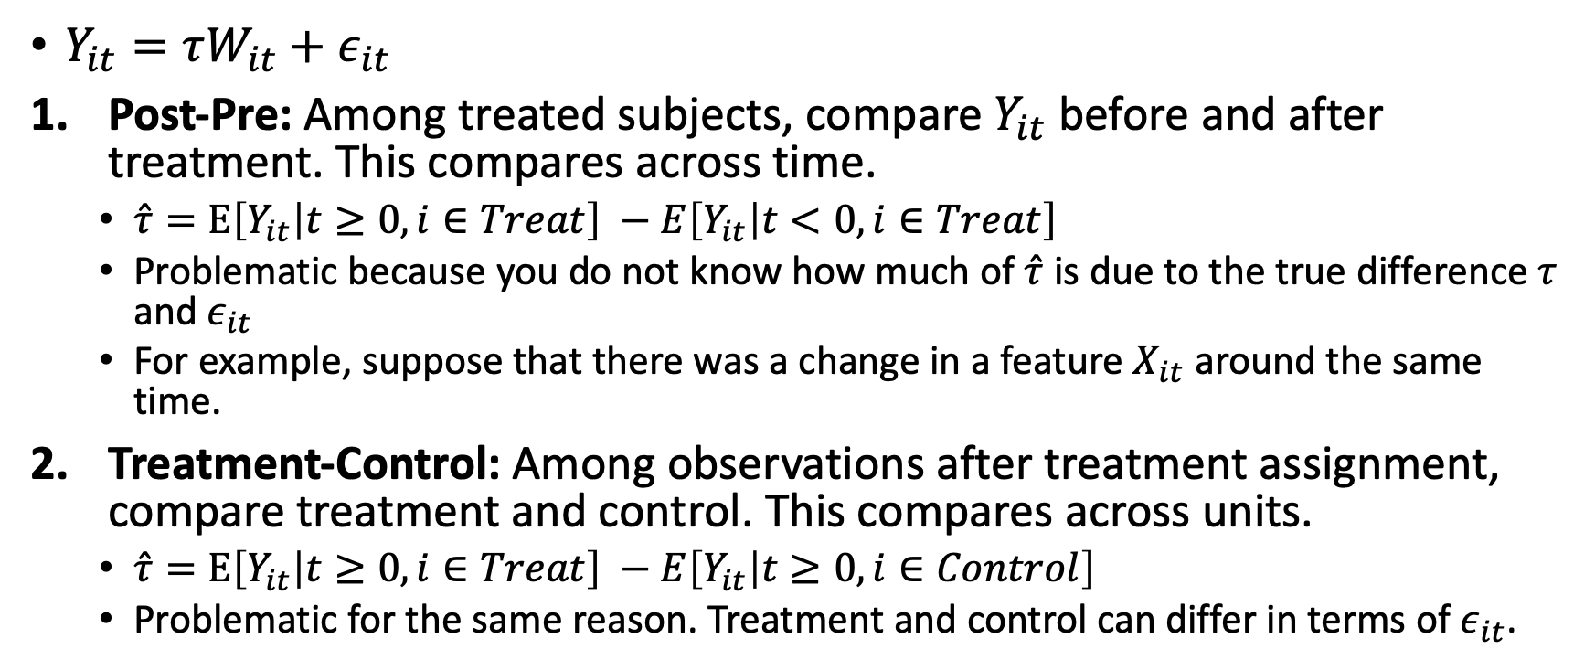
Two naïve comparisons
$Y_{it}=τW_{it}+ε_{it}$
Post-Pre: Among treated subjects, compare $Y_{it}$ before and after treatment. This compares across time.
$\hat{τ}=E\left[Y_{it} | t≥0, i∈Treat\right] −E\left[Y_{it} | t<0, i∈Treat\right]$
Problematic because you do not know how much of $\hat{τ}$ is due to the true difference $τ$ and $ε_{it}$
For example, suppose that there was a change in a feature $X_{it}$ around the same time.
Treatment-Control: Among observations after treatment assignment, compare treatment and control. This compares across units.
$\hat{τ}=E\left[Y_{it} | t≥0, i∈Treat\right] −E\left[Y_{it} | t≥0, i∈Control\right]$
Problematic for the same reason. Treatment and control can differ in terms of $ε_{it}$.

Slide 8
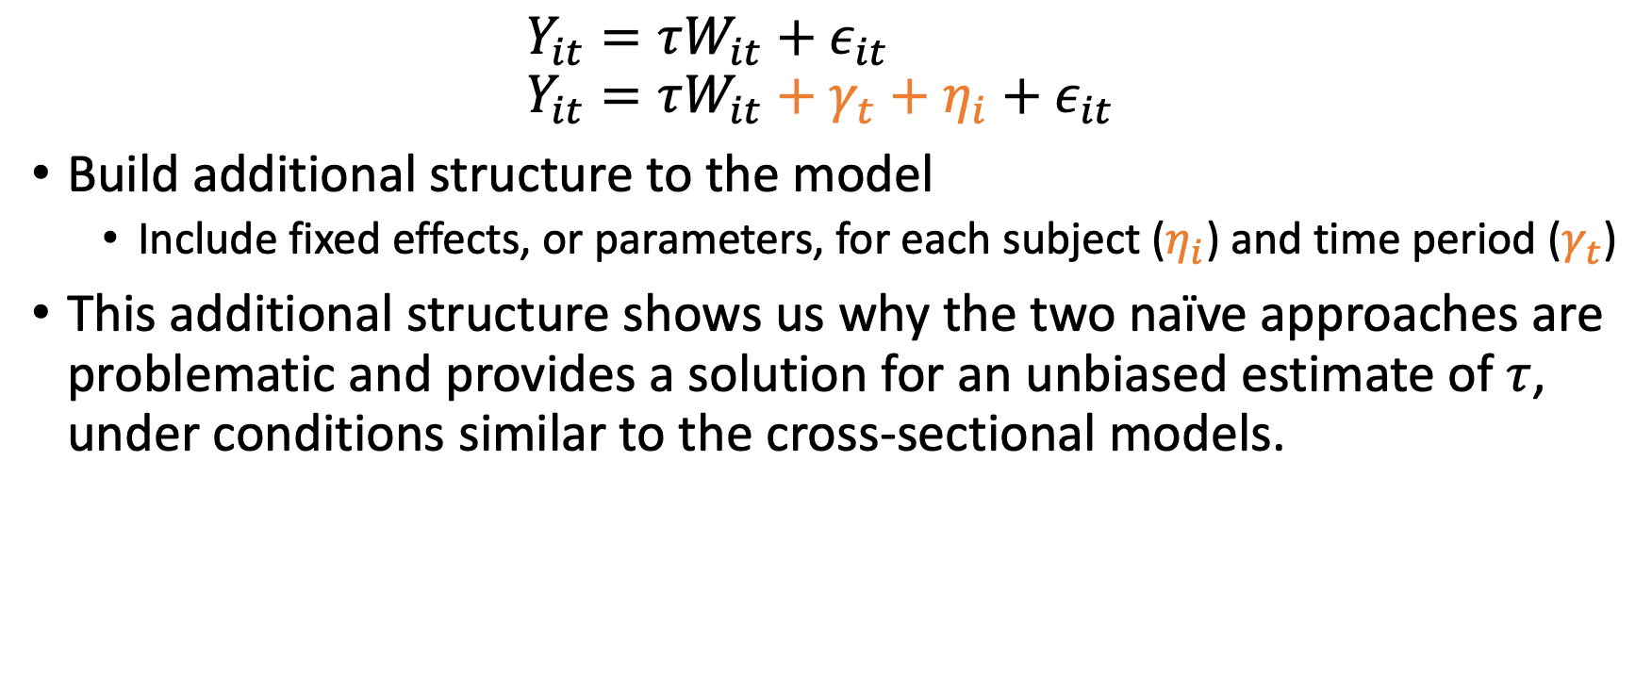
Instead, let’s compare across time and units
$$Y_{it}=τW_{it}+ε_{it}$$
$$Y_{it}=τW_{it}+γ_{t}+η_{i}+ε_{it}$$
Build additional structure to the model
Include fixed effects, or parameters, for each subject ($η_{i}$) and time period ($γ_{t}$)
This additional structure shows us why the two naïve approaches are problematic and provides a solution for an unbiased estimate of $τ$, under conditions similar to the cross-sectional models.

Slide 9
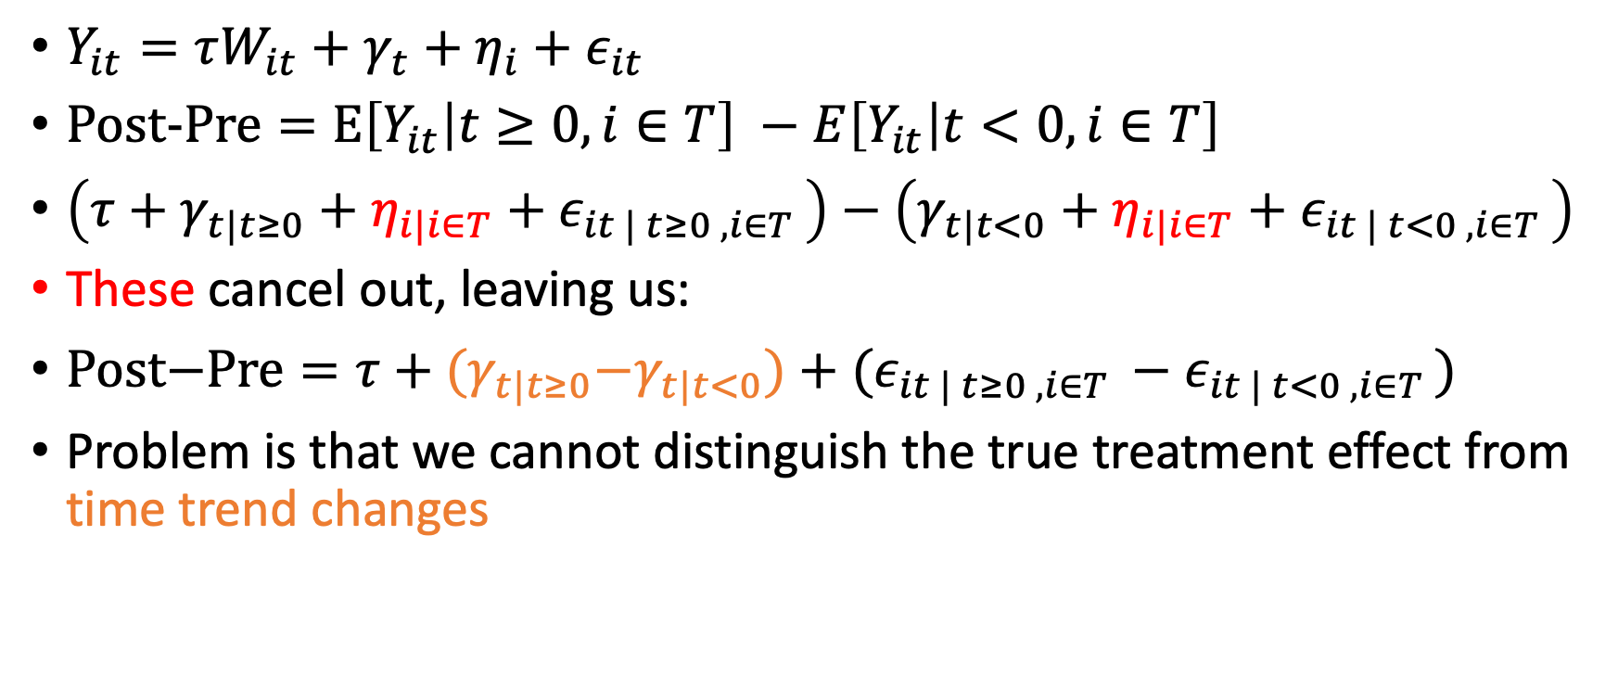
Revising the naïve comparison: Post-Pre
$Y_{it}=τW_{it}+γ_{t}+η_{i}+ε_{it}$
$\text{Post}\text{−}\text{Pre}=E\left[Y_{it} | t≥0, i∈T\right] −E\left[Y_{it} | t<0, i∈T\right]$
$\left(τ+γ_{t|t≥0}+η_{i|i∈T}+ε_{it | t≥0 , i∈T }\right)−\left(γ_{t|t<0}+η_{i|i∈T}+ε_{it | t<0 , i∈T }\right)$
These cancel out, leaving us:
$\text{Post}\text{−}\text{Pre}=τ+{(γ}_{t|t≥0}−γ_{t|t<0})+(ε_{it | t≥0 , i∈T }−ε_{it | t<0 , i∈T })$
Problem is that we cannot distinguish the true treatment effect from time trend changes

Slide 10
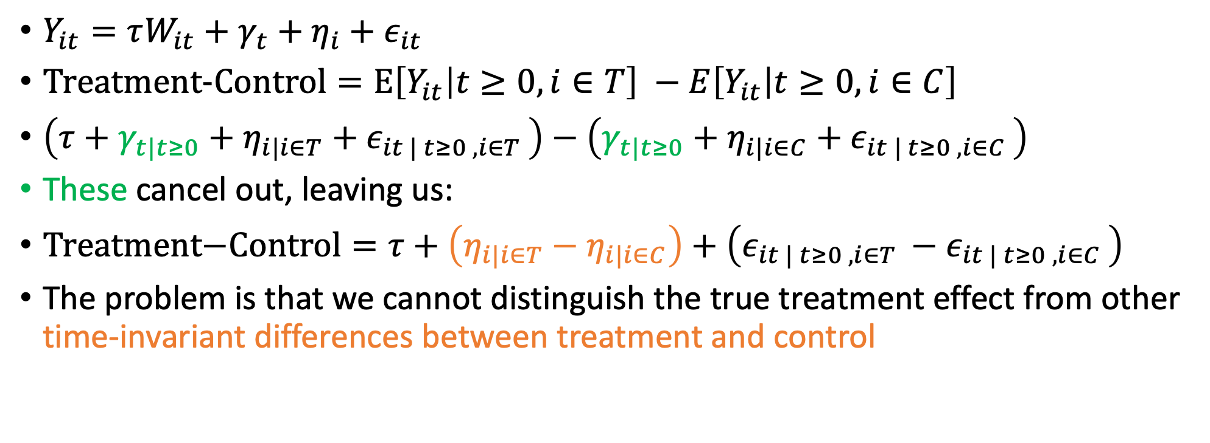
Revising the naïve comparison: Treatment-Control
$Y_{it}=τW_{it}+γ_{t}+η_{i}+ε_{it}$
$\text{Treatment}\text{−}\text{Control}=E\left[Y_{it} | t≥0, i∈T\right] −E\left[Y_{it} | t≥0, i∈C\right]$
$\left(τ+γ_{t|t≥0}+η_{i|i∈T}+ε_{it | t≥0 , i∈T }\right)−\left(γ_{t|t≥0}+η_{i|i∈C}+ε_{it | t≥0 , i∈C }\right)$
These cancel out, leaving us:
$\text{Treatment}\text{−}\text{Control}=τ+\left(η_{i|i∈T}−η_{i|i∈C}\right)+\left(ε_{it | t≥0 , i∈T }−ε_{it | t≥0 , i∈C }\right)$
The problem is that we cannot distinguish the true treatment effect from other time-invariant differences between treatment and control

Slide 11
Construct the diff-in-diff estimator
The naïve comparisons suffer from being unable to distinguish between time-variant and time-invariant differences between treatment and control.
Propose combining these two approaches to compensate for each others shortcomings:
Intuitively, take two differences:
1. Treatment subjects before and after treatment time; and
2. Control subjects before and after treatment time.
and then take the difference between them.

Slide 12
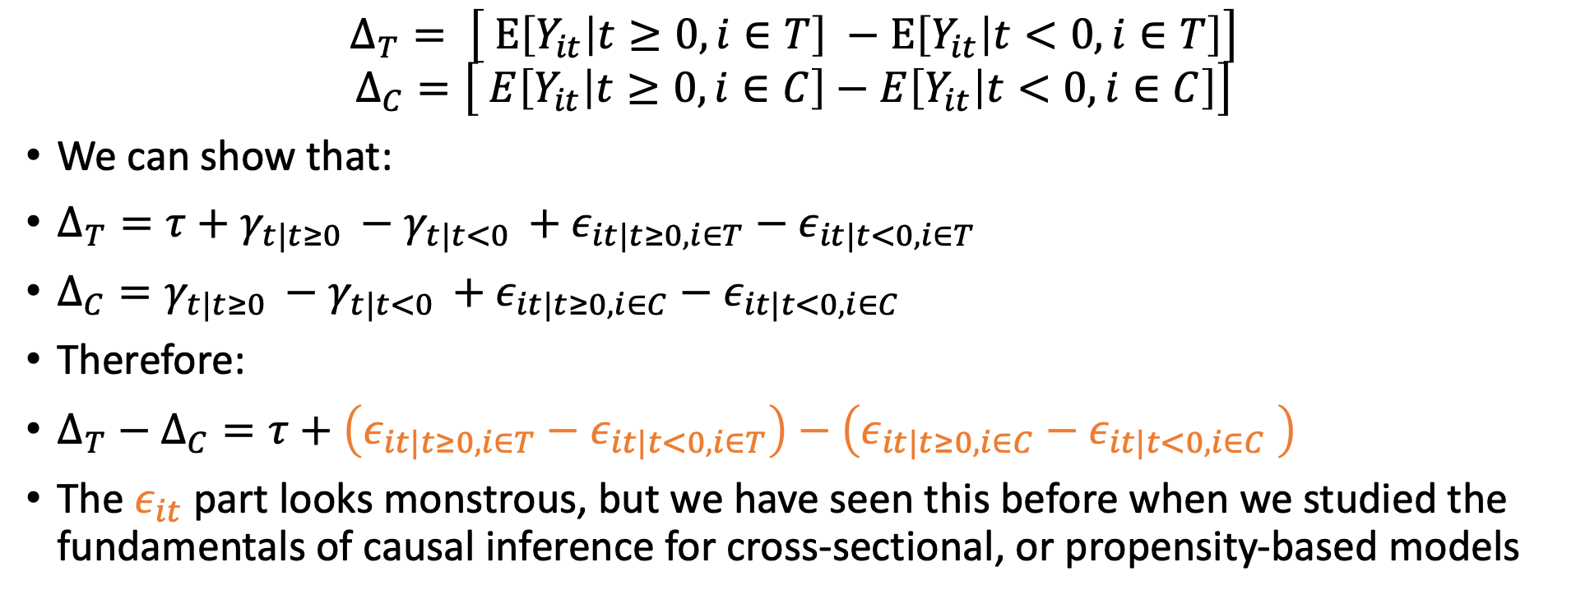
Diff-in-diff estimator
$$Δ_{T}= \left[ E\left[Y_{it} | t≥0, i∈T\right] −E\left[Y_{it} | t<0, i∈T\right]\right]$$
$$Δ_{C}=\left[ E\left[Y_{it} | t≥0, i∈C\right]−E\left[Y_{it} | t<0, i∈C\right]\right]$$
We can show that:
$Δ_{T}=τ+γ_{t|t≥0 }−γ_{t|t<0 }+ε_{it|t≥0, i∈T}−ε_{it|t<0, i∈T}$
$Δ_{C}=γ_{t|t≥0 }−γ_{t|t<0 }+ε_{it|t≥0, i∈C}−ε_{it|t<0, i∈C}$
Therefore:
$Δ_{T}−Δ_{C}=τ+\left(ε_{it|t≥0, i∈T}−ε_{it|t<0, i∈T}\right)−\left(ε_{it|t≥0, i∈C}−ε_{it|t<0, i∈C} \right)$
The $ε_{it}$ part looks monstrous, but we have seen this before when we studied the fundamentals of causal inference for cross-sectional, or propensity-based models

Slide 13
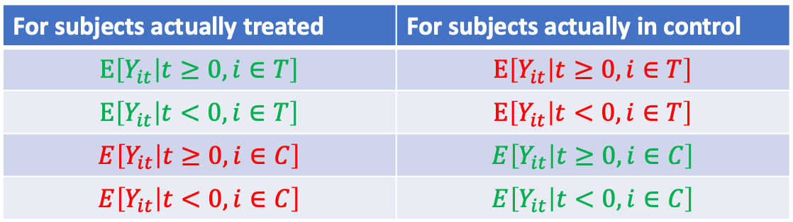
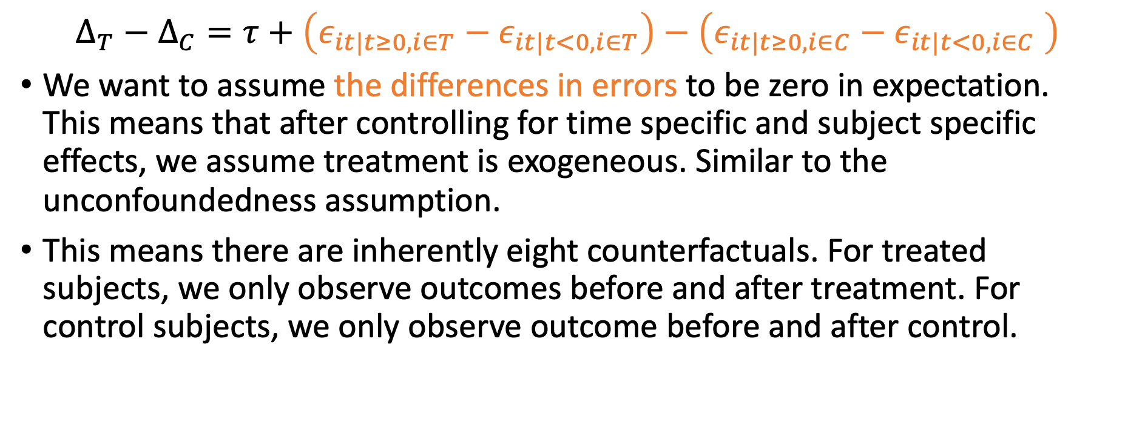
Unconfoundedness, again
$$Δ_{T}−Δ_{C}=τ+\left(ε_{it|t≥0, i∈T}−ε_{it|t<0, i∈T}\right)−\left(ε_{it|t≥0, i∈C}−ε_{it|t<0, i∈C} \right)$$
We want to assume the differences in errors to be zero in expectation. This means that after controlling for time specific and subject specific effects, we assume treatment is exogeneous. Similar to the unconfoundedness assumption.
This means there are inherently eight counterfactuals. For treated subjects, we only observe outcomes before and after treatment. For control subjects, we only observe outcome before and after control.
For subjects actually treated | For subjects actually in control
$$E\left[Y_{it} | t≥0, i∈T\right]$$ | $$E\left[Y_{it} | t≥0, i∈T\right]$$
$$E\left[Y_{it} | t<0, i∈T\right]$$ | $$E\left[Y_{it} | t<0, i∈T\right]$$
$$E\left[Y_{it} | t≥0, i∈C\right]$$ | $$E\left[Y_{it} | t≥0, i∈C\right]$$
$$E\left[Y_{it} | t<0, i∈C\right]$$ | $$E\left[Y_{it} | t<0, i∈C\right]$$
Observed
Not observed

Slide 14
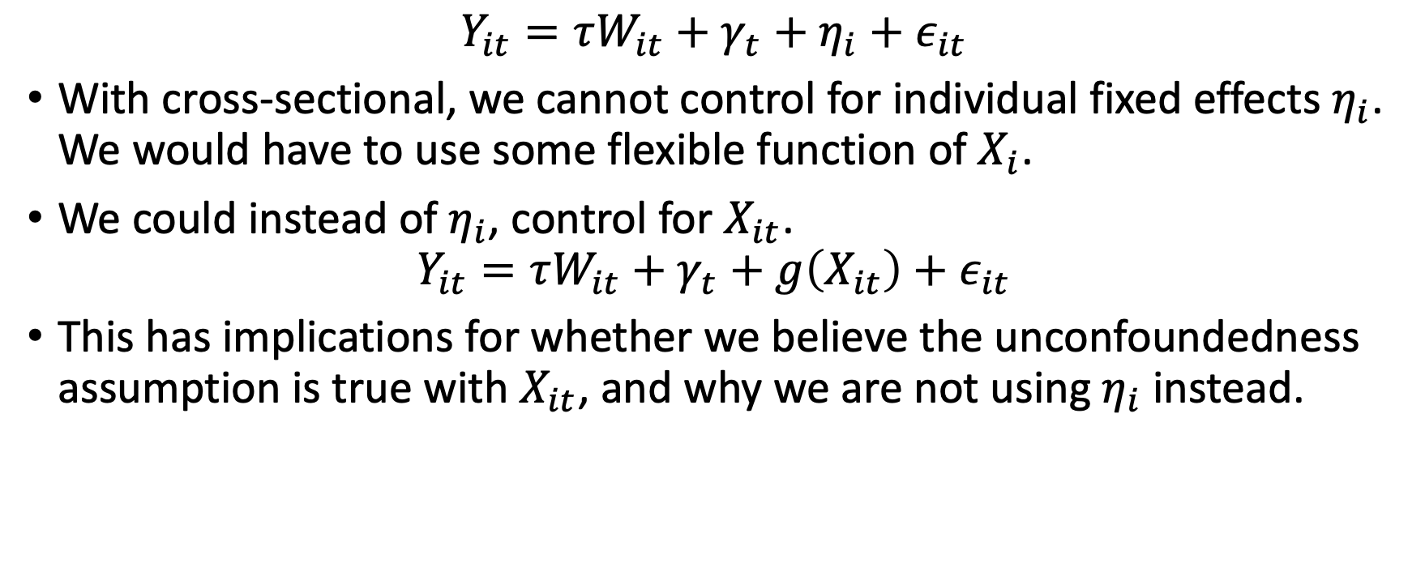
Panel data’s advantage over cross-sectional data
$$Y_{it}=τW_{it}+γ_{t}+η_{i}+ε_{it}$$
With cross-sectional, we cannot control for individual fixed effects $η_{i}$. We would have to use some flexible function of $X_{i}$.
We could instead of $η_{i}$, control for $X_{it}$.
$$Y_{it}=τW_{it}+γ_{t}+g\left(X_{it}\right)+ε_{it}$$
This has implications for whether we believe the unconfoundedness assumption is true with $X_{it}$, and why we are not using $η_{i}$ instead.
Notes:
A cool advantage of contolling for X_i instead of the subject fixed effects is that it gives you more flexibility for modifications such as dynamic learning or dynamic discrete choice models. These are very much outside the scope of these materials.

Slide 15
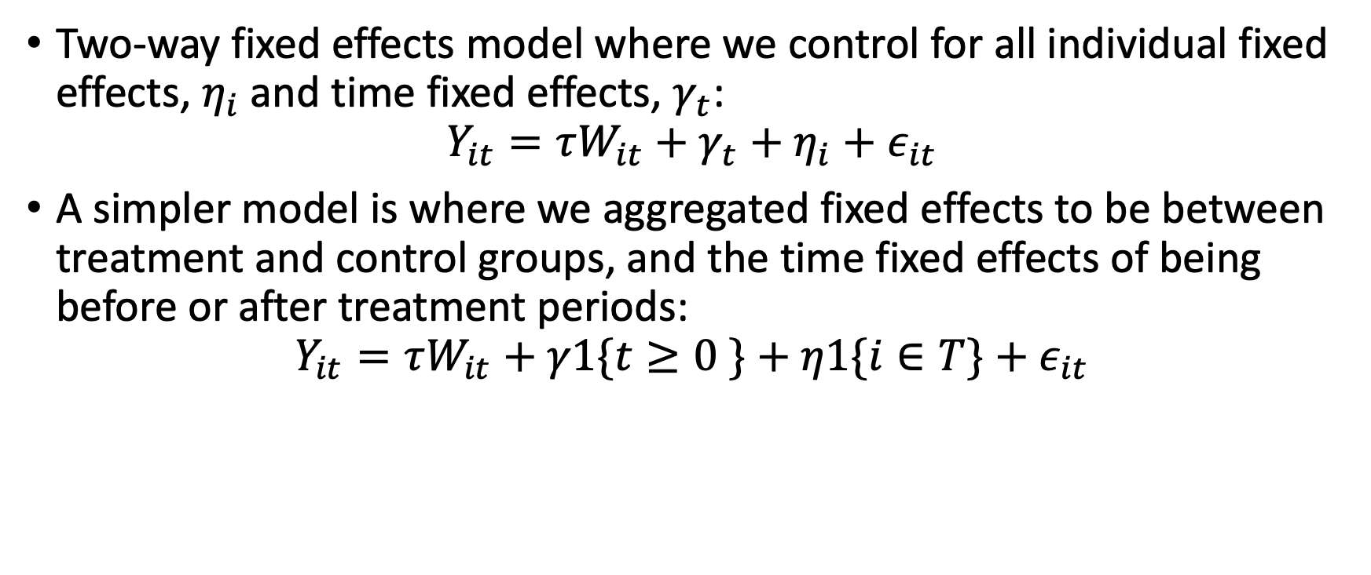
Difference-in-difference model
Two-way fixed effects model where we control for all individual fixed effects, $η_{i}$and time fixed effects, $γ_{t}$:
$$Y_{it}=τW_{it}+γ_{t}+η_{i}+ε_{it}$$
A simpler model is where we aggregated fixed effects to be between treatment and control groups, and the time fixed effects of being before or after treatment periods:
$$Y_{it}=τW_{it}+γ1\{t≥0 \}+η1\{i∈T\}+ε_{it}$$

Slide 16
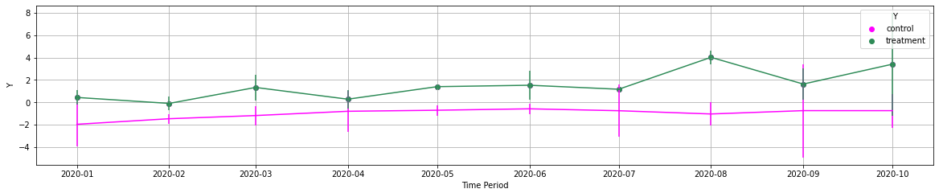
Let’s see this come out in simulation evidence
We generate a panel of outcome data, with seven pre-treatment periods, and three post-treatment periods.
Pre-treatment Periods
Post-Treatment Periods

Slide 17
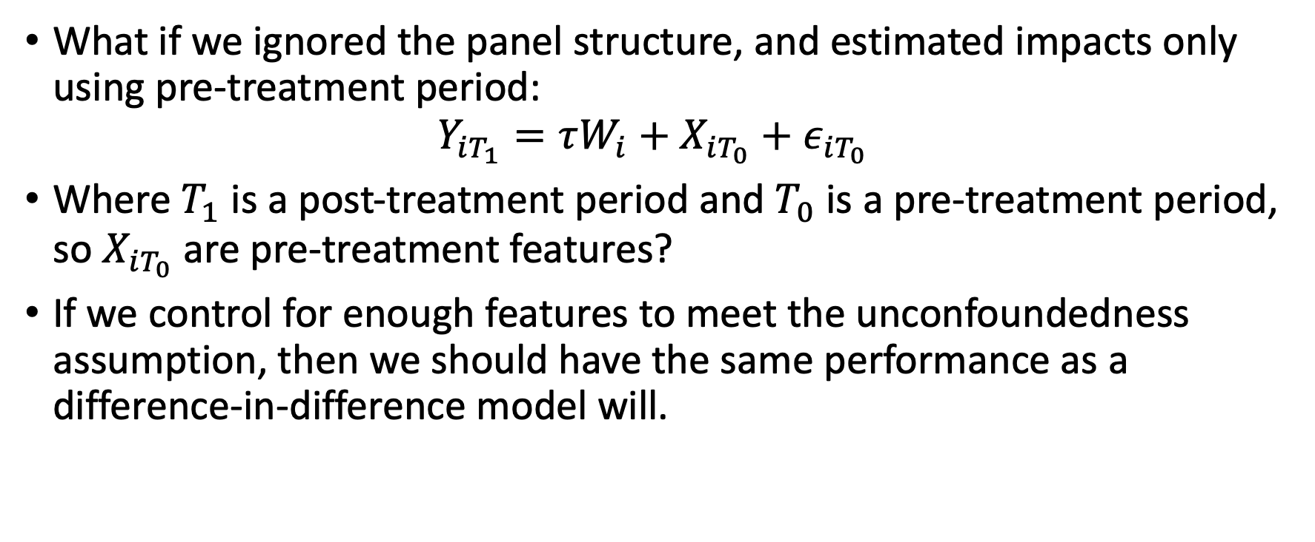
Compare performance of cross-sectional to panel methods
What if we ignored the panel structure, and estimated impacts only using pre-treatment period:
$$Y_{iT_{1}}=τW_{i}+X_{iT_{0}}+ε_{iT_{0}}$$
Where $T_{1}$ is a post-treatment period and $T_{0}$ is a pre-treatment period, so $X_{iT_{0}}$ are pre-treatment features?
If we control for enough features to meet the unconfoundedness assumption, then we should have the same performance as a difference-in-difference model will.
Notes:
In applications, we cannot as easily assume that we assume enough data to meet the unconfoundedness assumption, and this is another vote for DnD models.

Slide 18
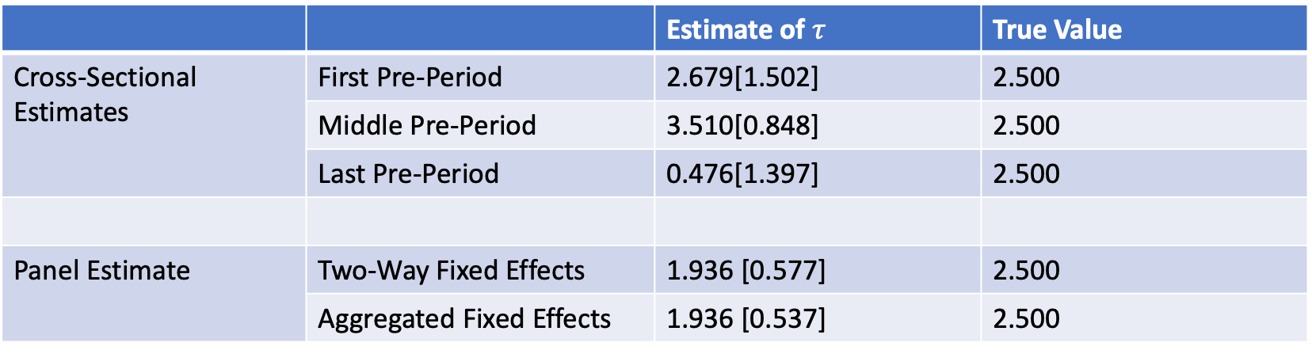
Simulation evidence of cross-sectional and panel data
 |  | Estimate of $τ$ | True Value
Cross-Sectional Estimates | First Pre-Period | 2.679[1.502] | 2.500
 | Middle Pre-Period | 3.510[0.848] | 2.500
 | Last Pre-Period | 0.476[1.397] | 2.500
Panel Estimate | Two-Way Fixed Effects | 1.936 [0.577] | 2.500
 | Aggregated Fixed Effects | 1.936 [0.537] | 2.500
Performance of cross-sectional models can vary over pre-treatment periods, but we have more consistent performance

Slide 19
Arguable validation using panel data

Slide 20
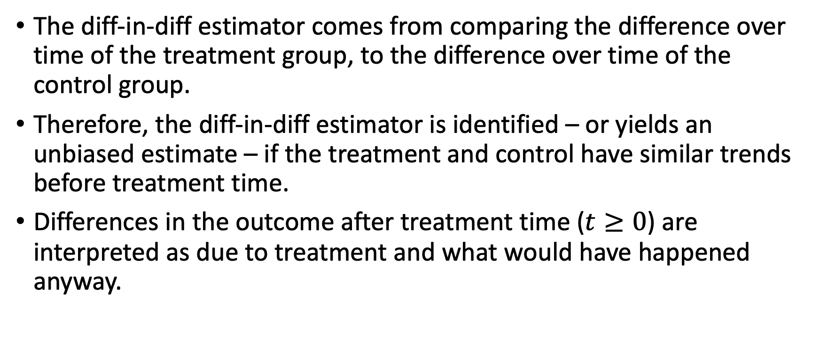
Difference-in-difference
The diff-in-diff estimator comes from comparing the difference over time of the treatment group, to the difference over time of the control group.
Therefore, the diff-in-diff estimator is identified – or yields an unbiased estimate – if the treatment and control have similar trends before treatment time.
Differences in the outcome after treatment time ($t≥0$) are interpreted as due to treatment and what would have happened anyway.

Slide 21



Visual representation – Two Differences
Outcome, $Y_{it}$
Treatment
Difference post-treatment
Control
Difference pre-treatment
Pre-treatment, $t<0$
Post-treatment, $t≥0$

Slide 22

Visual representation – Difference in Differences
Treatment
Outcome, $Y_{it}$
Treatment Effect
Estimated counterfactual of treatment
Control
Pre-treatment, $t<0$
Post-treatment, $t≥0$

Slide 23
Pre-trend tests
If treatment and control groups do not have parallel trends in outcomes pre-treatment, then we cannot distinguish how much of the post-treatment difference is due to the true treatment effect and what would have happened anyway.
If the treatment was on a different trajectory of the control, then how can we be sure how the treatment would have behaved if it were not treated?

Slide 24
Visual representation – No Parallel Trends
Treatment
Outcome, $Y_{it}$
Treatment Effect
Estimated counterfactual of treatment
Control
Pre-treatment, $t<0$
Post-treatment, $t≥0$

Slide 25
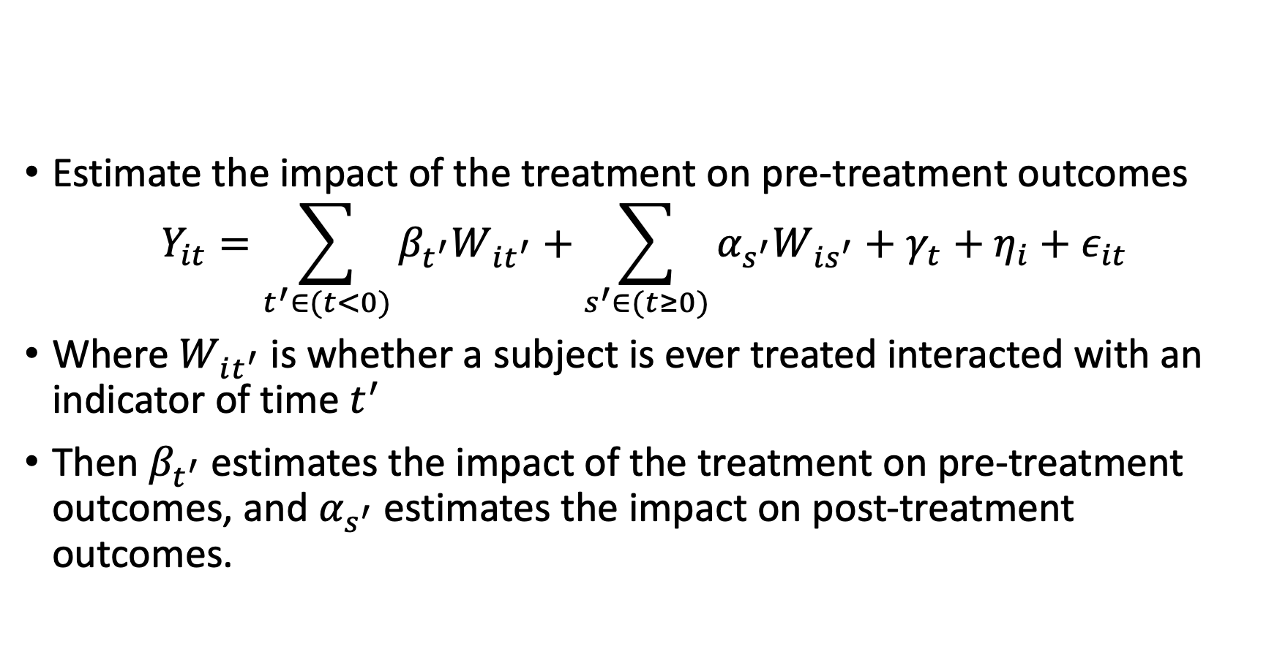
Pre-trend tests
Estimate the impact of the treatment on pre-treatment outcomes
$$Y_{it}=\sum_{t^{′}∈(t<0)}{β_{t^{′}}W_{it^{′}}+\sum_{s^{′}∈(t≥0)}{α_{s^{′}}W_{is^{′}}}}+γ_{t}+η_{i}+ε_{it}$$
Where $W_{it^{′}}$ is whether a subject is ever treated interacted with an indicator of time $t^{′}$
Then $β_{t^{′}}$ estimates the impact of the treatment on pre-treatment outcomes, and $α_{s^{′}}$ estimates the impact on post-treatment outcomes.

Slide 27
Staggered treatment time

Slide 28
Identification deep dive

Slide 29
Identification deep dive
Controlling for lagged outcome or not, and its implication for inference
Controlling for features instead of fixed effects

Slide 30
Continuous treatments

